Slide 1
WELCOME TO GIBBS HIGH SCHOOL
HOME OF THE EAGLES

Slide 2
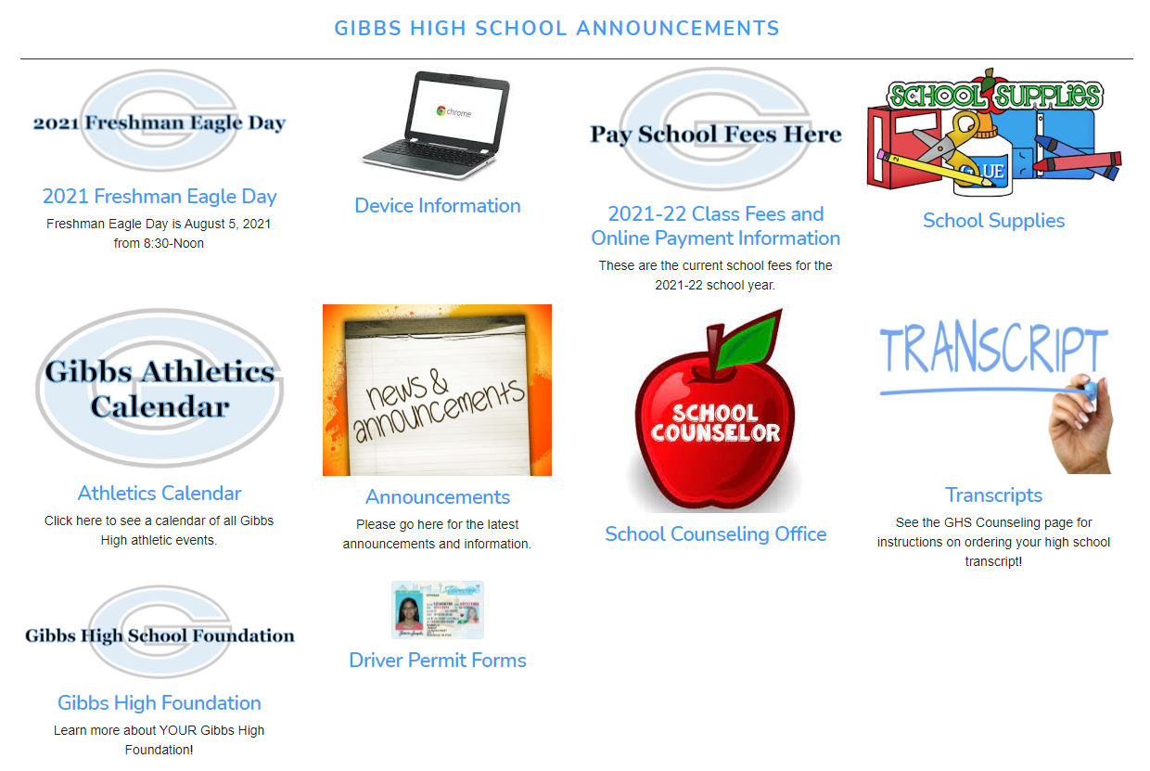
Daily Announcements
You can also find daily announcements on our school website by clicking the icon!

Slide 3
Important Dates
January 25 – Early Release Day
February 8 – 4.5 Week Grading Period
February 15 – Early Release Day
February 20 – President’s Day – In-Service Day
March 7 – ACT – Juniors
March 10 – 9 Week Grades
March 13-17 – Spring Break
March 22 – Early Release Day
April 7 – Good Friday Holiday
April 10 – In-Service Day

Slide 4
Get Connected!
^{@GibbshsEagles}

Slide 5
Get Connected!
^{@GibbsEagles}
^{Counselors: @GibbsCounseling}
^{Yearbook: @GHSEagleYrbk}
^{Mr. Webster: @Gibbsprincipal}

Slide 6
Student Handbook
The Gibbs High School Student Handbook can be found at www.knoxschools.org/gibbshs
Find Our School at the top and choose General Information in the drop-down menu. Click on Student Handbook.

Slide 7
Counseling Department
Cheyenne Pack Students A-D
Malee Hogan Students E-K
Marissa Buchanan Students L-Ri
Sarah Draper Students Ro-Z

Slide 8
Technology Reminders
Technology Device Agreement due
Device Insurance paid by 9/30 ($20)
3. Do NOT put stickers on your chromebook!
4. Do NOT use paint or markers near your chromebook!
5. Do NOT eat snacks or food or drink near your chromebook!
6. Chromebook should be charged and ready each day. NO CHARGERS WILL BE LOANED!
7. Do NOT charge your phones using your chromebook!

Slide 9
2023 Eagle Yearbook
On Sale Now!
Early Bird Price
$65
Ends February 24th

Slide 10
“A lot of kids we recruit play multiple sports, and I think that’s how it should be. Players should be able to experience high school and play as many sports as they want. That’s how I grew up.” Dana Holgorsen Head Football Coach University of Houston

Slide 11
Athletic Events
Upcoming Sports:
1/20 – Basketball vs Seymour
1/21 – Wrestling District Duals
1/23 – Basketball vs Claiborne
1/24 – Wrestling Region Duals @ Halls
1/24 – Basketball @ Northview
1/26 – Wrestling Sectional Duals
1/28 – Girls Wrestling @ Alcoa
1/31 – Basketball @ Anderson Co
2/3 – Basketball vs Halls
2/4 – Wrestling TSSAA State Duals

Slide 12
Get Involved!!!
National Honor Society Student Council
Spanish Honor Society FBLA
Scholar’s Bowl Link UP
Student Newspaper French Club
Art Club Book Club
Unified Sports HOSA
Teens for Christ DECA
National Technical Honor Society
Habitat for Humanity TSA
Early Morning Bible Study FCA

Slide 13
Students of the Month
November
9th Grade
Landon Harris Emily Harper
10th Grade
Matthew McClead Maven Dykes

Slide 14
Students of the Month
November
11th Grade
Logan Dudley Skylar Harrell
12th Grade
Bryson Palmer Abigail Crabtree

Slide 15
#PrideInThe

Slide 16
raduation begins today.

